Slide 1
Introduction to C++

Slide 2
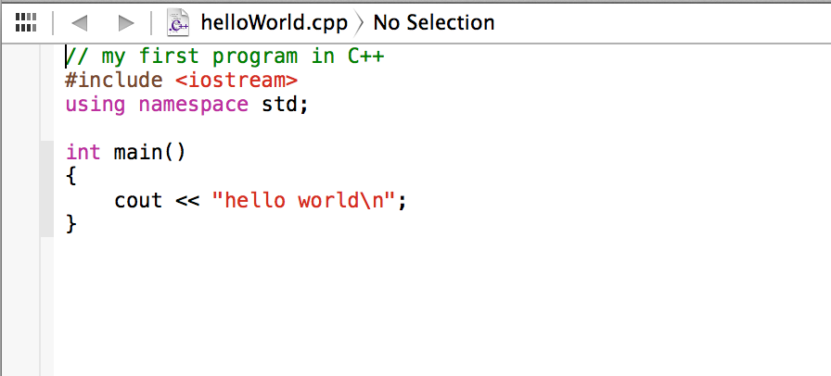
Parts of C++ Program
comment
Preprocessor directive
namespace
iostream: header file
std: namespace
main: function
int: type
cout: object
<<: stream insertion operator
helloworld\n: string literal/string constant
\n: escape sequence

Slide 3
Special Characters
Character | Name | Description
// | Double slash | //this is a comment
# | Pound sign | #include # define
<> | Opening and closing brackets | #include <filename>
() | Opening and closing parentheses | int calculateSum(3,4)
{} | Opening and closing braces | int main() { }
“” | Quotation marks | cout << “hello”
; | Semicolon | cout << “example”;
\ | Back slash | count << “new line \n”

Slide 4
Escape Sequences
Escape Sequence | Name | Description
\n | Newline | move the cursor to a new line
\t | Horizontal tab | move the cursor to the next tab stop
\a | Alarm | cause the computer to beep
\b | Backspace | move the cursor left by one position
\r | Return | move the cursor to the beginning of the line
\\ | Backslash | print \
\’ | Signe quote | print ‘
\” | Double quote | print “

